Slide 1

CS4225/CS5425 Big Data Systems for Data Science
NoSQL Overview
Bryan Hooi
School of Computing
National University of Singapore
bhooi@comp.nus.edu.sg

Slide 2
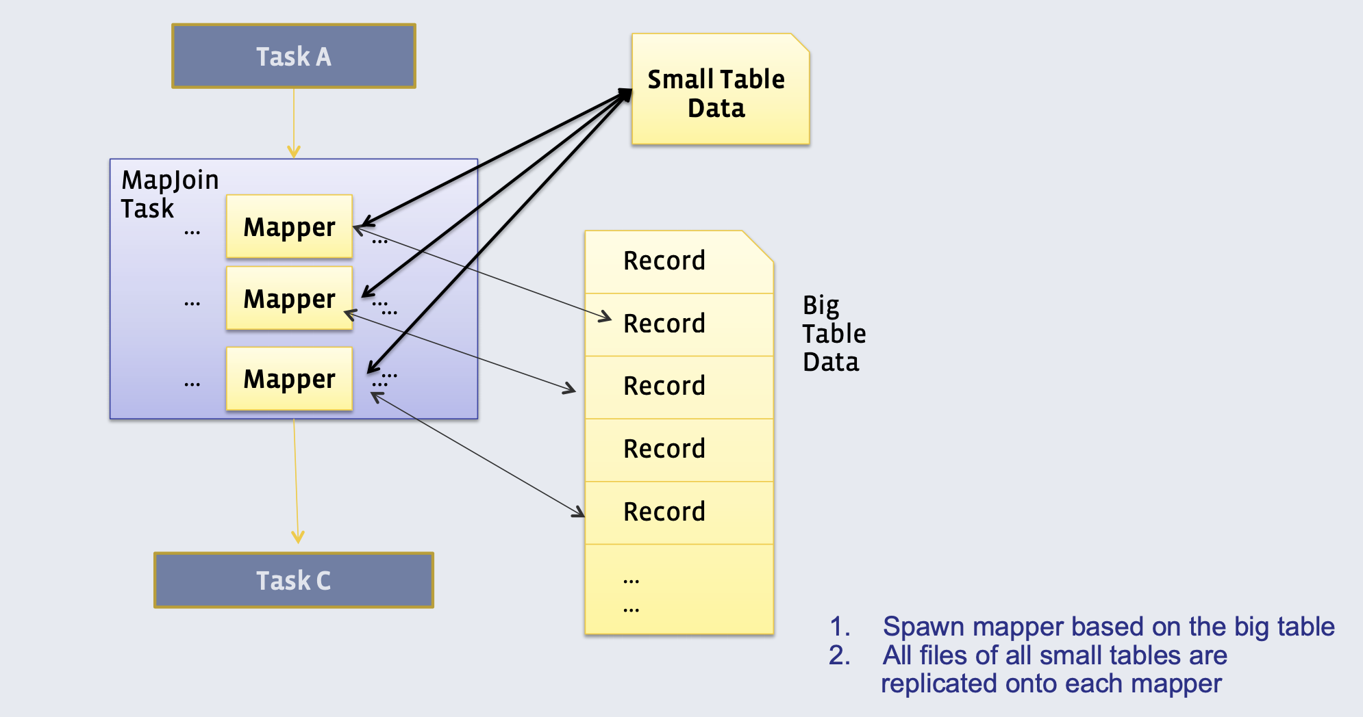
Recap: Broadcast (or Map) Join
Requires one of the tables to fit in memory
All mappers store a copy of the small table, as a hash table
They iterate over the big table, and join the records with the small table
{0: [SG, MY],
1: [SG], …}

Slide 3
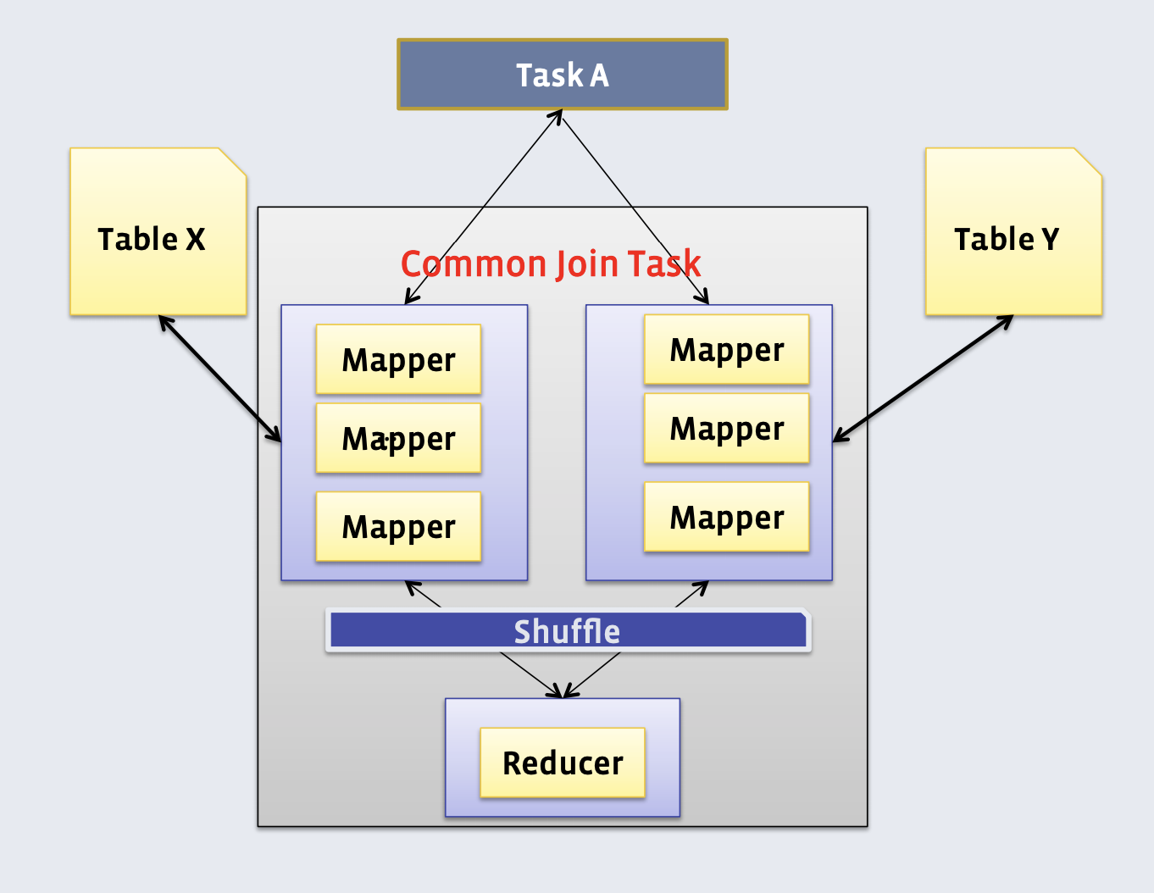
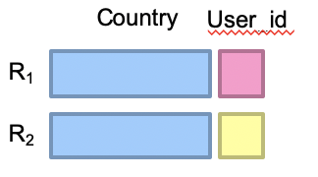
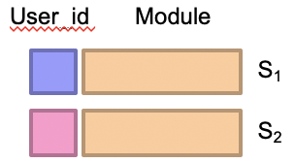
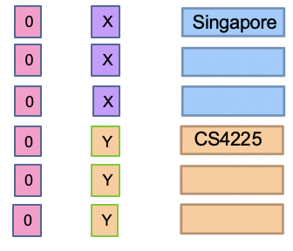
Recap: Reduce-side (‘Common’) Join
Doesn’t require a dataset to fit in memory, but slower than map-side join
Different mappers operate on each table, and emit records, with key as the variable to join by
Table X X
Table Y X
Singapore
0
0
CS4225
Map
Map
(0, X, Singapore)
(0, Y, CS4225)
key
Secondary key
Notes:
All the tuples from R with the same join key will be encountered ﬁrst, which
the reducer can buﬀer in memory. As the reducer processes each tuple from
S , it is crossed with all the tuples from R. Of course, we are assuming that
the tuples from R (with the same join key) will ﬁt into memory, which is a
limitation of this algorithm (and why we want to control the sort order so that
the smaller dataset comes ﬁrst).
The basic idea behind the reduce-side join is to repartition the two datasets by the join key. The approach isn’t particularly efficient since it requires shuf- fling both datasets across the network.

Slide 4
Recap: Near-Duplicate Document Search
Shingles:
{ (the cat),
(cat is),
(is glad) }
“the cat is glad…”
Signature: 182……231
Shingling
MinHash
Compare signatures to get candidate pairs
Document
Pr[h(C₁) = h(C₂)] = Jaccard-Sim(C₁, C₂)

Slide 5
Recap: Key Property of MinHash
Key property: the probability that two documents have the same MinHash signature is equal to their Jaccard similarity!
Formally: Pr[h(C₁) = h(C₂)] = Jaccard-Sim(C₁, C₂)
Proof (not required knowledge):
Document 1
Document 2
{ (the cat), (cat is), (is glad) }
{ (no cat), (cat is), (is glad) }
Hashes:
32
12
24
93
12
24
MinHash = 12
MinHash = 12
Set of all our tuples:
{(the cat), (no cat), (cat is), (is glad)}
Jaccard sim = 2/4 = 0.5
(2 non-shared shingles)
(2 shared shingles)
Among these 4 tuples, each has the same probability of having the smallest hash value.
if one of the red shingles has the smallest hash, the documents will have the same MinHash.
Otherwise, they will have different MinHashes.
=> Pr[h(C₁) = h(C₂)] = (red shingles / total shingles) = (intersection / union) = Jaccard similarity

Slide 6
Recap: K-Means Algorithm
1. Initialization: Pick K random points as centers
2. Repeat:
a) Assignment: assign each point to nearest cluster
Centers
b) Update: move each cluster center to average of its assigned points
Stop if no assignments change

Slide 7
MapReduce Implementation v1
This MapReduce job performs a single iteration of k-means. It takes in the current positions of the cluster centers c (i.e. stars in last slide)
Append a “1” at the end of point p’s coordinates. This allows us to simply accumulate points by summing (in reducer’s line 5), in which case these “1”s keep track of the number of points in a cluster (and used for computing the centroid)
Note: each such emit() call transmits O(d) bytes of data across the network, since a point p has d dimensions
Emit() is called n times since there are n data points, further multiplied by m (# iterations)
Notes:
To apply this to the MapReduce framework, we find the cluster membership for each point in the mapper, emitting the point’s nearest cluster number as the key and the point itself as the value. The points are extended by one dimension and initialized to a value of one to represent the count for cluster normalization. For simplicity, we load the current cluster estimate into memory in the mapper; however, later we will discuss a method that can be used when the clusters are too large to fit into memory. The MapReduce framework will group the points by their nearest cluster. The reducer sums all of the points and normalizes to produce the updated cluster center, which is emitted as the value with the key being the cluster number. A ‘driver’ program orchestrates the communication of the new clusters to the mapper during the next k-means iteration. In practice the previous implementation will perform poorly as the entire dataset will be transferred over the network during the shuffle phase, resulting in a bottleneck due to the high network traffic. We can dramatically improve the performance by observing that the cluster mean computation requires the sum of all of the points and their cardinality.

Slide 8
MapReduce Implementation v2 (with in-mapper combiner)
In each iteration, Emit() is called once for each cluster, i.e., k times in total. H{n} sums the (extended) points assigned to cluster n.
Notes:
In-Mapper Combiner
By using the in-mapper combining design pattern, the initial algorithm is modified to not emit during calls to the Map method, and instead accumulate the partial sums until the Close method is called after all of the input has been processed. This decreases the amount of data that is emitted between the mapper to the combiner and the time taken to sort the mapper’s output for the combiner.

Slide 9
Today’s Plan
What is NoSQL?
Major types of NoSQL systems
Key concepts
We will see, but no need to remember for test / HW:
Historical details
Writing code in any NoSQL systems (e.g. MongoDB)
Details about any specific NoSQL systems
Source: Cattell (2010). Scalable SQL and NoSQL Data Stores. SIGMOD Record.

Slide 10
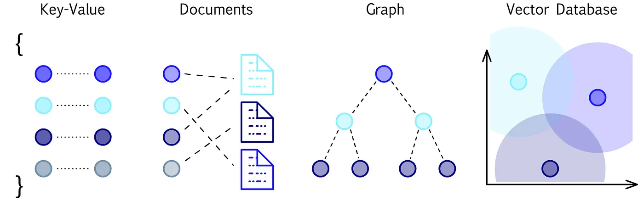
What is NoSQL?
NoSQL mainly refers to a non-relational database, i.e. it stores data in a format other than relational tables
”SQL” here refers to traditional relational database management systems (“DBMS”)
(This is a slight misnomer; here “SQL” is used to refer to relational databases, not the querying language. In fact, NoSQL systems can involve SQL-like querying languages in many cases.)
NoSQL has come to stand for “Not Only SQL”, i.e. using relational and non-relational databases alongside one another, each for the tasks they are most suited for
Notes:
NoSQL databases are just databases that don’t fit the traditional mold of relational databases. They are quite diverse and it is not that there is any one thing common to all of them – they are just different from traditional relational DBs.
Not Only SQL: represents the philosophy that NoSQL shouldn’t be a substitute for relational databases – they each have the tasks they are most suitable for, and can be used alongside one another.

Slide 11
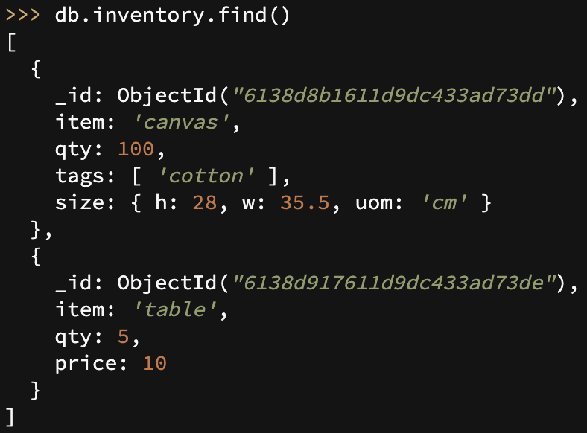
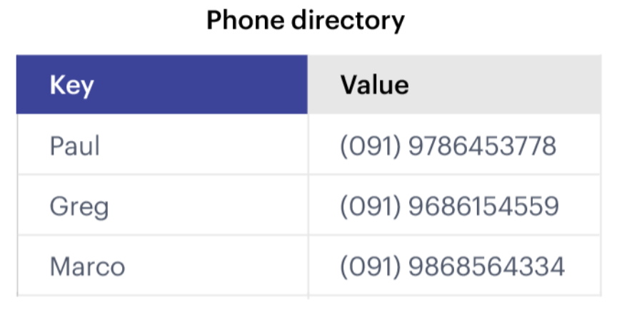


What is NoSQL?
Traditional Relational Database Management System (DBMS)
(Document Store)
(Key-Value Store)

Slide 12


Metaphor: NoSQL = No Rules?
Relational Databases
Non-Relational Databases (NoSQL)
NoSQL (Non-Relational Databases)

Slide 13

Who uses NoSQL?

Slide 14
Why NoSQL: Growth in Web Applications
Notes:
Web application data is growing faster than business transaction data (which we would generally use relational DBs for). This is the gap that NoSQL is trying to address – large volumes of web application data that is not nicely structured and fitting into the use-cases associated with standard relational DBs.

Slide 15
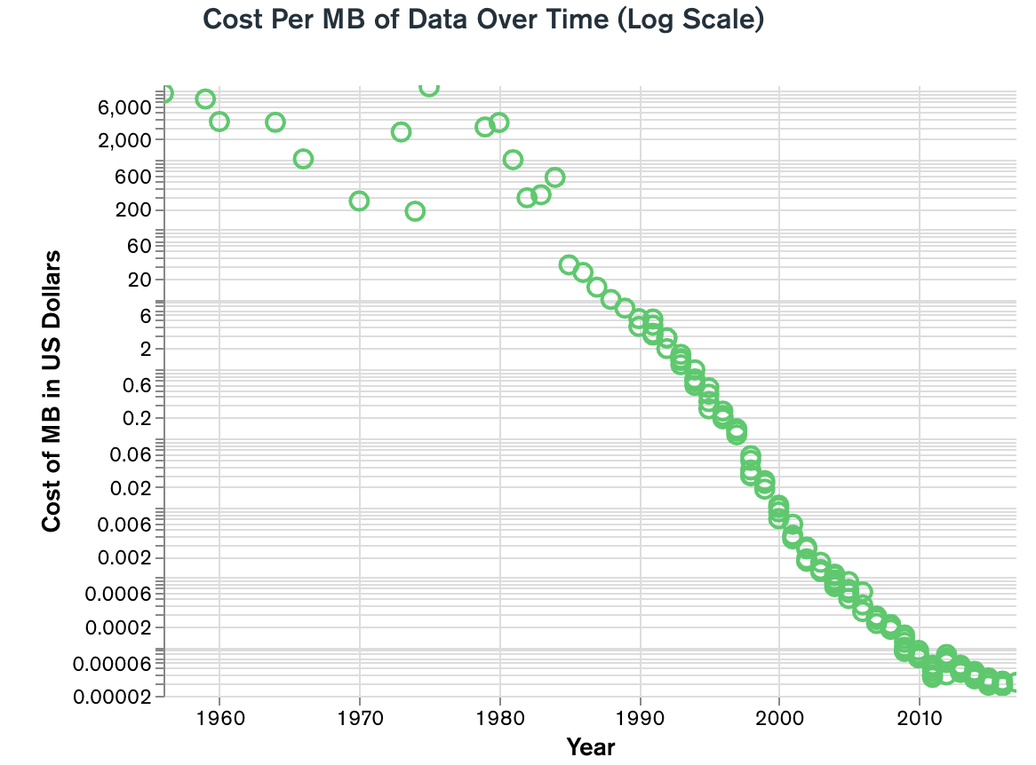
Why NoSQL: Volume, Velocity

Slide 16
A Brief Overview of NoSQL Systems
Horizontally scalability
Replicate/distribute data over many servers
Simple call interface
Often weaker concurrency model than RDBMS
Efficient use of distributed indexes and RAM
Flexible schemas
Volume, Velocity
Variety
Source: Cattell (2010). Scalable SQL and NoSQL Data Stores. SIGMOD Record.

Slide 17
Today’s Plan
What is NoSQL?
Major types of NoSQL systems
Key concepts
Source: Cattell (2010). Scalable SQL and NoSQL Data Stores. SIGMOD Record.

Slide 18








(Major) Types of NoSQL databases
Key-value stores
Wide column databases
Document stores
Graph databases
Vector databases

Slide 19

Key-Value Stores
Source: Wikipedia (Keychain)

Slide 20
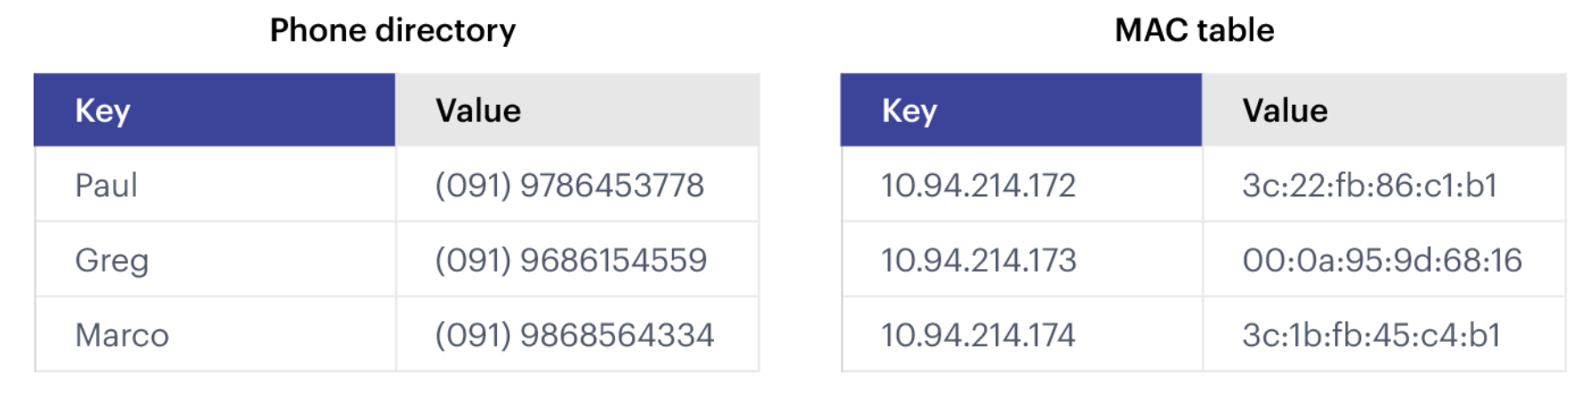
Key-Value Stores: Data Model
Stores associations between keys and values
Based on Amazon’s Dynamo paper (2007)
Keys are usually primitives and can be queried
For example, ints, strings, raw bytes, etc.
Values can be primitive or complex; usually cannot be queried
Examples: ints, strings, lists, JSON, HTML fragments, BLOB (basic large object), etc.
DeCandia, Giuseppe, et al. "Dynamo: Amazon's highly available key-value store." ACM SIGOPS operating systems review 41.6 (2007): 205-220.
Notes:
It supports very simple but flexible data models.

Slide 21
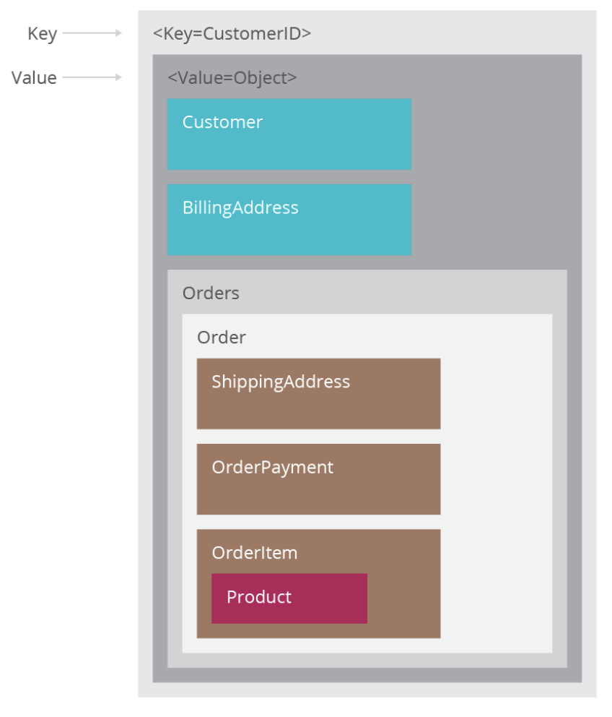
Key-Value Stores: Operations
Very simple API:
Get – fetch value associated with key
Put – set value associated with key
Optional operations:
Multi-get
Multi-put
Range queries
Suitable for:
Small continuous read and writes
Storing ‘basic’ information (e.g. raw chunks of bytes), or no clear schema
When complex queries are not required / rarely required
Example Applications
Storing user sessions
Caches
User data that is often processed individually: e.g. patient medical data?
Only if no queries like ‘How many patients who took X treatment recovered?’
Notes:
If we mostly just need to read and write individual objects, this is a very suitable use-case for key-value stores, and they can execute this very quickly, and support high data volume
However, if we need to perform more complex queries over the contents of many values, this is less suitable (such queries can still be supported, but require iterating over many objects, which is less of an ideal use-case)

Slide 22
Key-Value Stores: Implementation
Non-persistent:
Just a big in-memory hash table
Examples: Memcached, Redis
(But: these can also back up the data to disk periodically)
Persistent
Data is stored persistently to disk
Examples: RocksDB, Dynamo, Riak

Slide 23
Document Stores
DeCandia, Giuseppe, et al. "Dynamo: Amazon's highly available key-value store." ACM SIGOPS operating systems review 41.6 (2007): 205-220.
Source: Wikipedia (Keychain)

Slide 24
Document Stores: Document Model
ID
Field
Document
Value
Document
Collection
A database can have multiple collections
Collections have multiple documents
A document is a JSON-like object: it has fields and values
Different documents can have different fields
Can be nested: i.e. JSON objects as values
Notes:
It supports very simple but flexible data models.

Slide 25
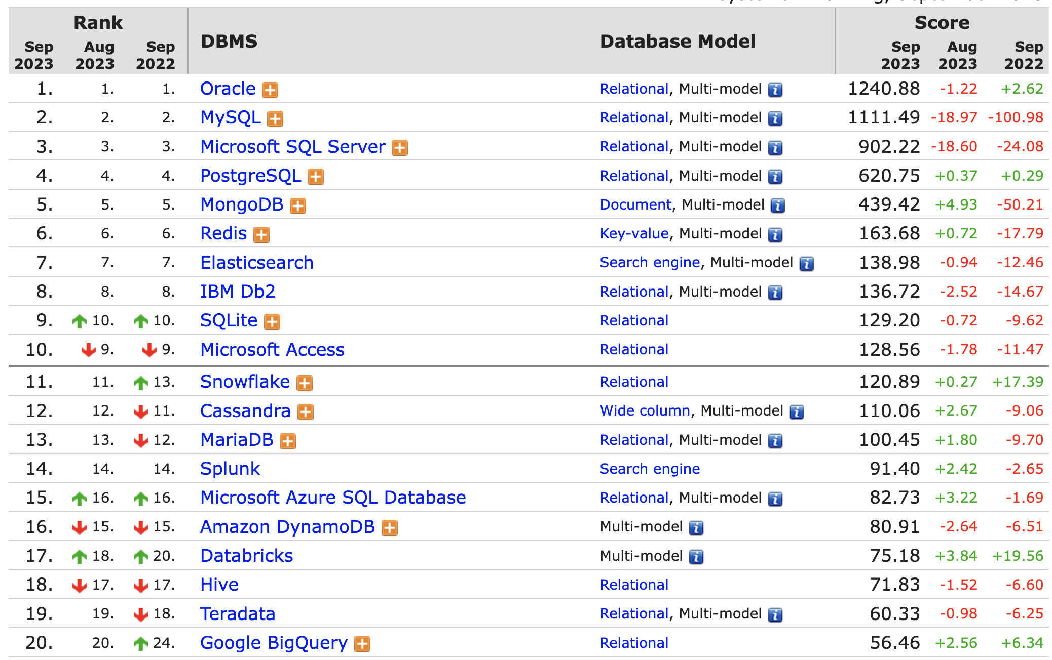
Popularity of DBMS

Slide 26
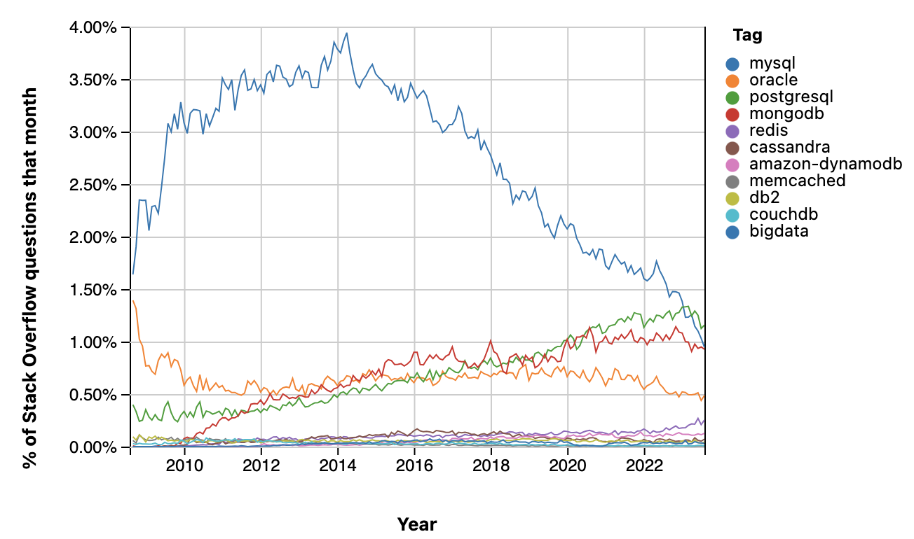
Stack Overflow Trends
Source: https://insights.stackoverflow.com/

Slide 27
Document Stores: Querying
Unlike (basic) key value stores, document stores allow some querying based on the content of a document
CRUD = Create, Read, Update, Delete

Slide 28
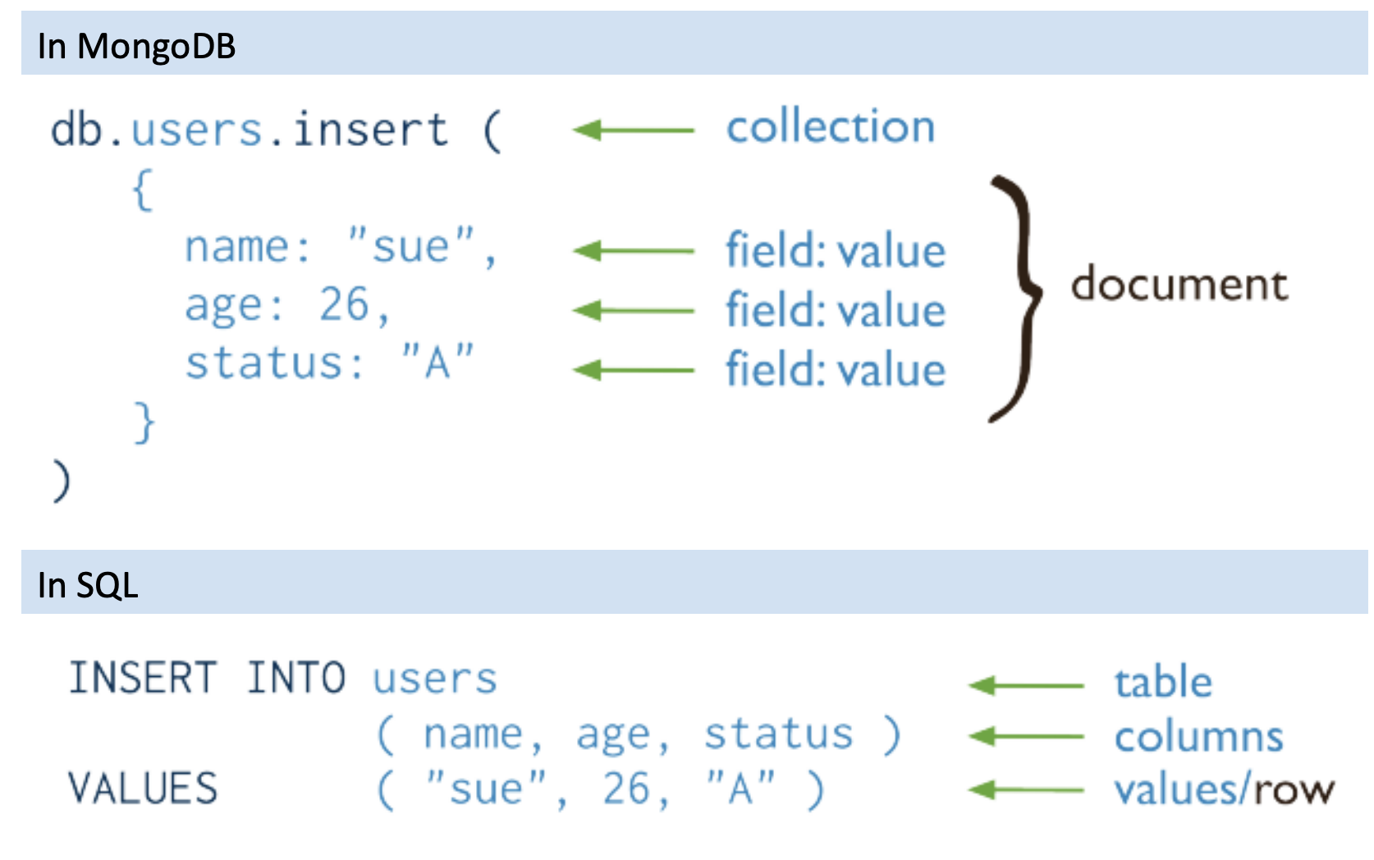
CRUD: Create

Slide 29
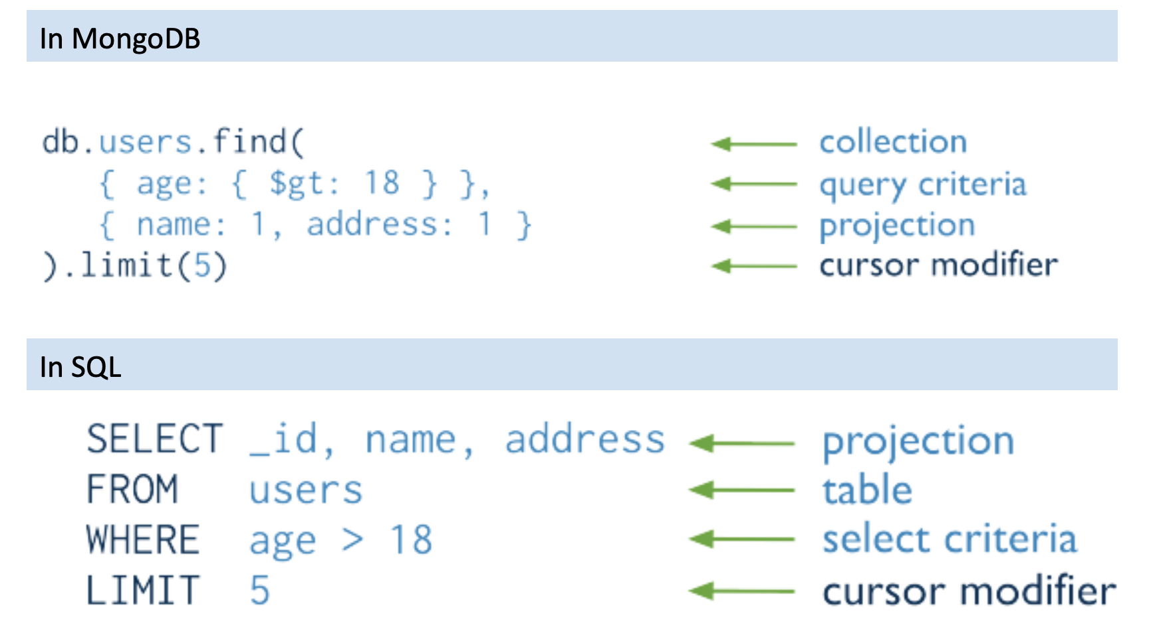
CRUD: Read

Slide 30
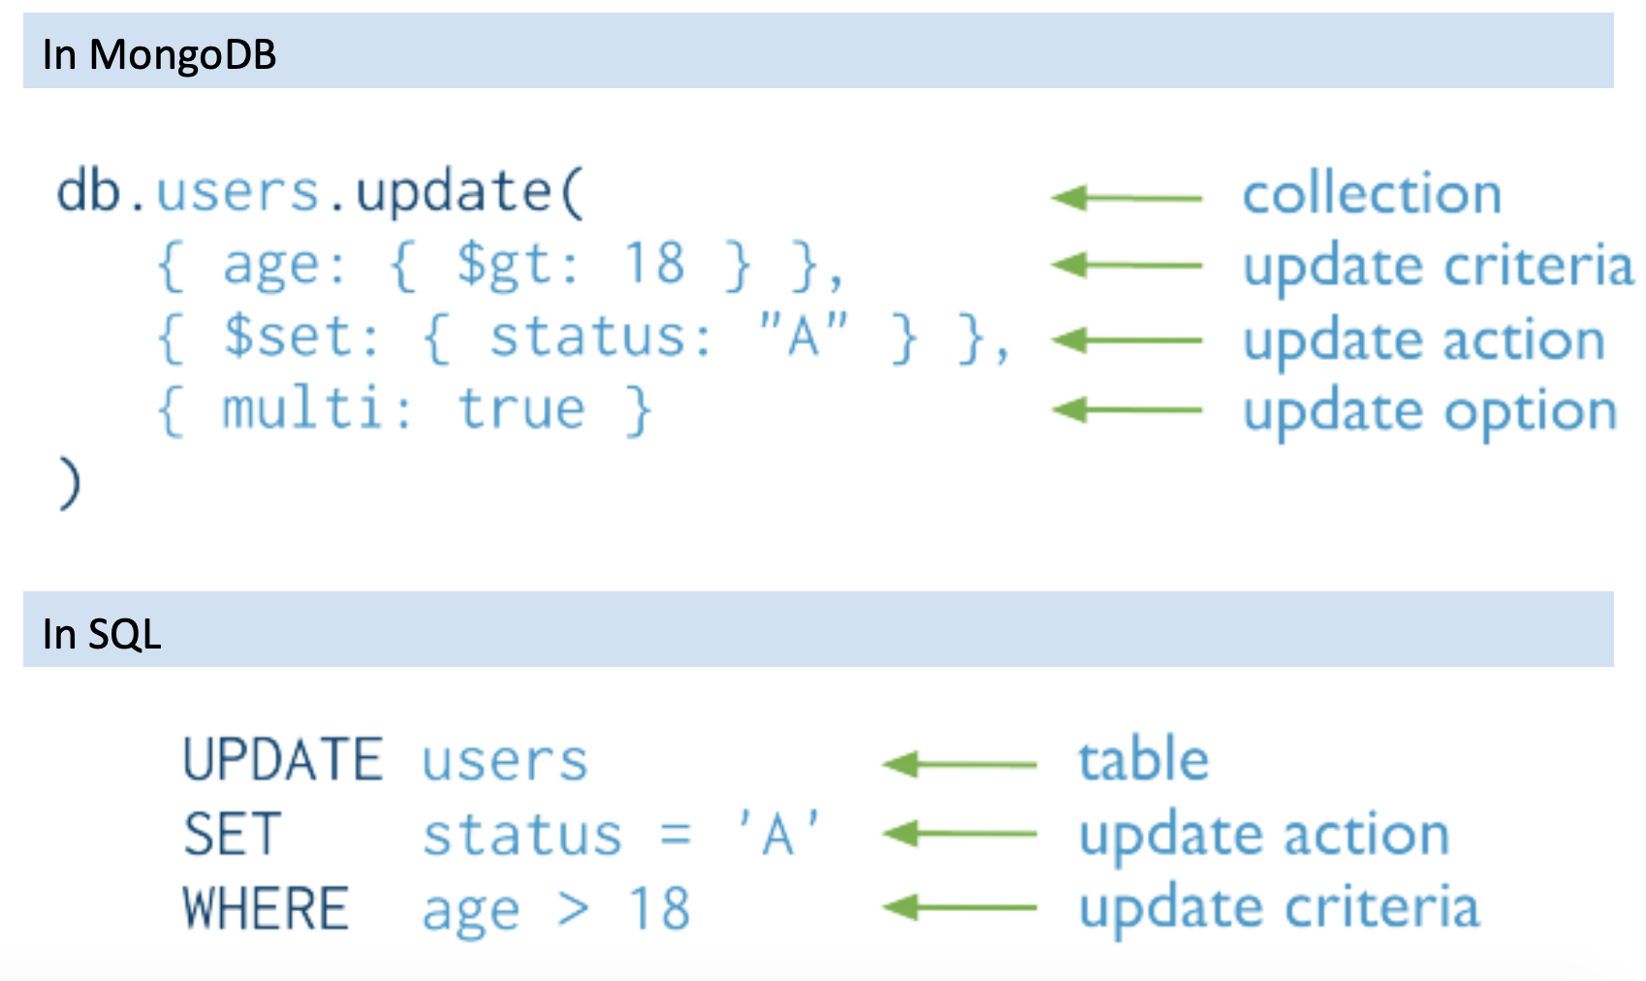
CRUD: Update
Notes:
Important difference: in mongodb we don’t have a strict schema, so we cannot assume that all rows have the same fields. E.g. a tuple may not have the “age” field. In this case, when executing the above Update query, we will not select tuples without the “age” field. MongoDB has some specific rules on how to handle cases like this, which are out of scope for this class but when using the system, it is important to take into consideration such possibilities.

Slide 31
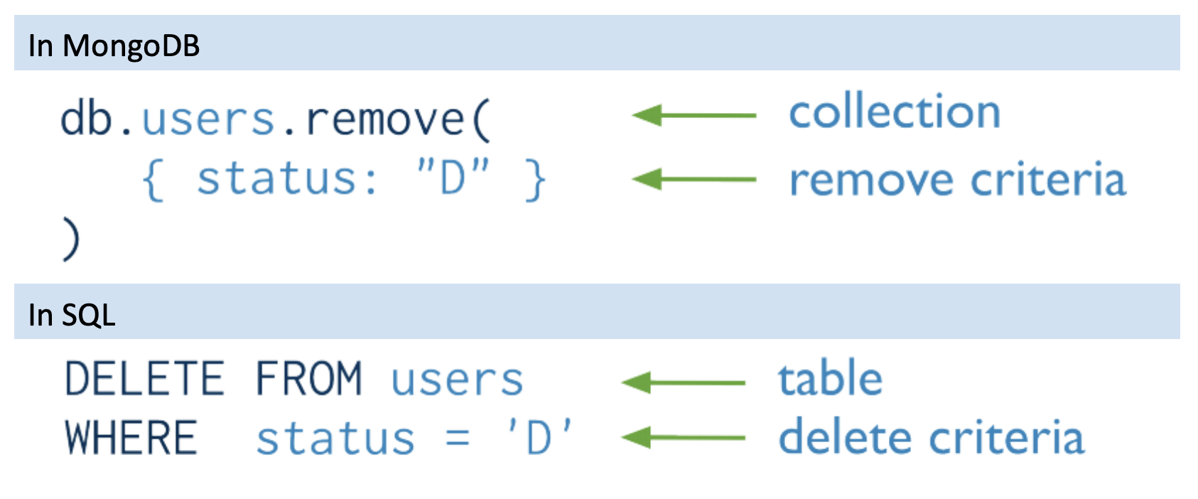
CRUD: Delete

Slide 32
Wide Column Stores
Rows describe entities
Related groups of columns are grouped as column families
Sparsity: if a column is not used for a row, it doesn’t use space
Examples: BigTable, Cassandra, HBase
https://cloud.google.com/bigtable/docs/overview

Slide 33
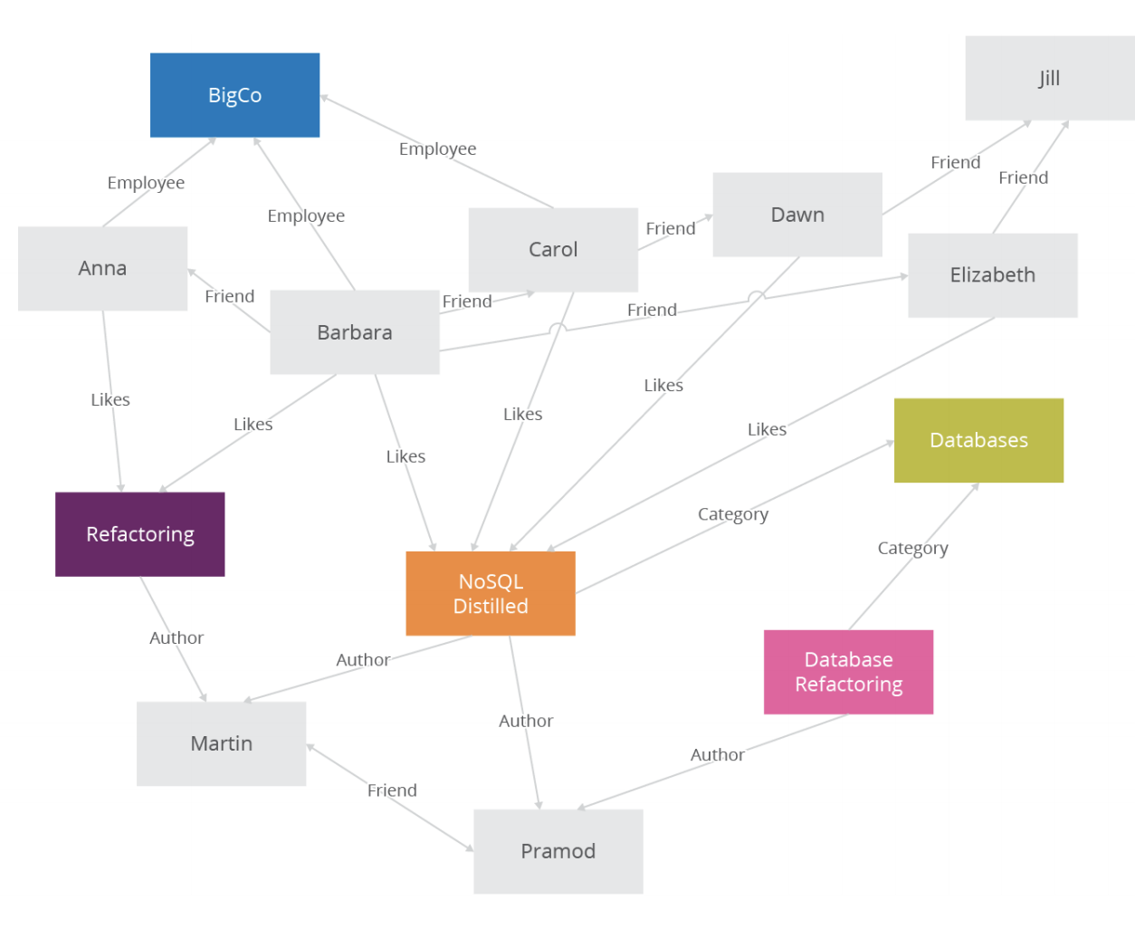
Graph Databases

Slide 34
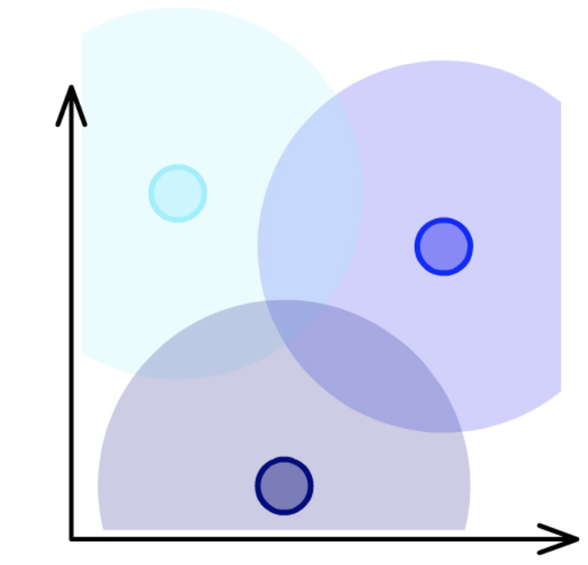
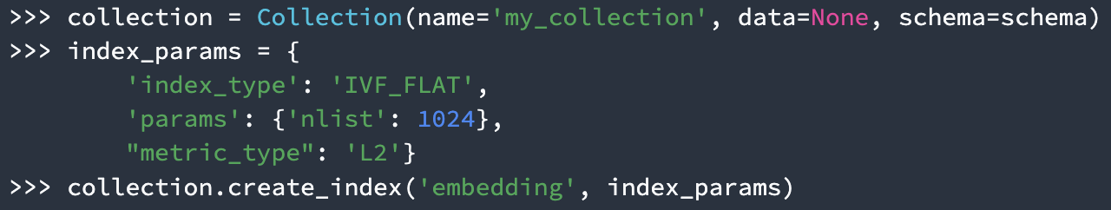
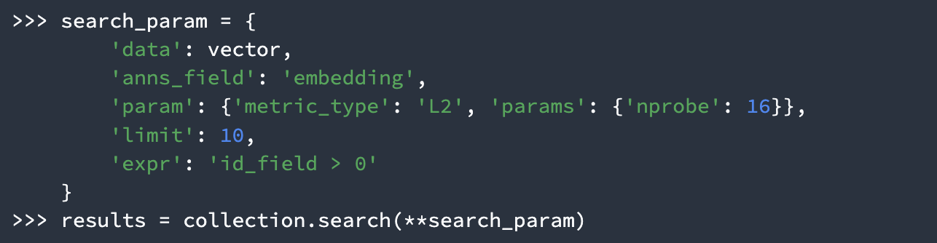
Vector Databases
Store vectors (i.e., each row represents a point in d dimensions)
Usually dense, numerical, and high-dimensional
Allow fast similarity search, i.e., given a query, retrieve similar neighbors from the database.
Earlier in class we discussed similarity search using min-hashing. One of the major types of algorithms used in vector databases is locality-sensitive hashing (LSH), which is closely related to min-hashing.
DB features: scalability, real-time updates, replication
Examples: Milvus, Redis, Weaviate, MongoDB Atlas

Slide 35
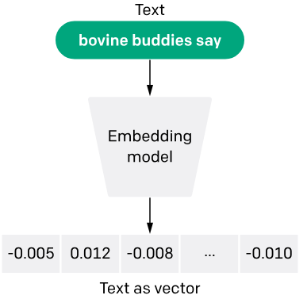
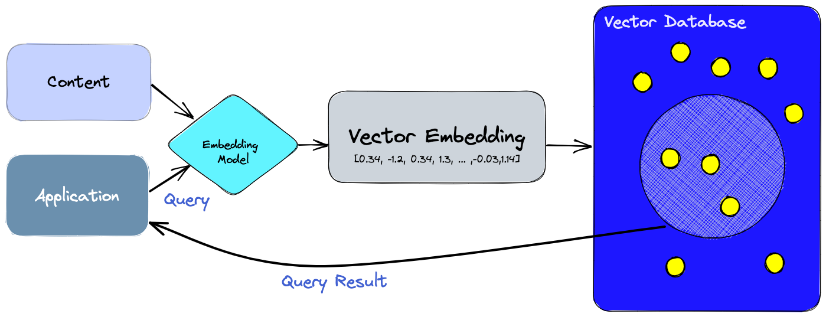
Vector Databases in AI / ML
Vector DBs have become a hot topic recently due to AI / ML
Large language models are often used to convert some text into vectors (or embeddings) useful for applications like search, recommendation, clustering
Similarly, vision models convert images into embeddings
To quickly search for similar embeddings (e.g., for search / recommendation), efficient and scalable vector DBs are needed

Slide 36
Today’s Plan
What is NoSQL?
Major types of NoSQL systems
Key concepts
Eventual Consistency
Duplication
Source: Cattell (2010). Scalable SQL and NoSQL Data Stores. SIGMOD Record.

Slide 37
Strong vs Eventual Consistency
Weight=50kg
Weight=50kg
Weight=50kg
Weight=50kg
Weight=50kg
Weight=50kg
Strong consistency: any reads immediately after an update must give the same result on all observers
Eventual consistency: if the system is functioning and we wait long enough, eventually all reads will return the last written value

Slide 38
Strong vs Eventual Consistency
Weight=60kg
Weight=60kg
Weight=60kg
Weight=60kg
Weight=50kg
Weight=60kg
60kg
60kg
60kg
50kg
All readers read new value (60kg)
Readers may read old value (50kg)
Strong consistency: any reads immediately after an update must give the same result on all observers
Eventual consistency: if the system is functioning and we wait long enough, eventually all reads will return the last written value

Slide 39
Strong vs Eventual Consistency
Weight=60kg
Weight=60kg
Weight=60kg
Weight=60kg
Weight=60kg
Weight=60kg
60kg
60kg
60kg
60kg
All readers read new value (60kg)
Eventually, the update is propagated to Node C; after which, readers will read the correct value
Strong consistency: any reads immediately after an update must give the same result on all observers
Eventual consistency: if the system is functioning and we wait long enough, eventually all reads will return the last written value

Slide 40
Eventual Consistency
ACID vs BASE: Relational DBMS provide stronger (ACID) guarantees, but many NoSQL system relax this to weaker “BASE” approach:
Basically Available: basic reading and writing operations are available most of the time
Soft State: without guarantees, we only have some probability of knowing the state at any time
Eventually Consistent: Contrast to “strong consistency”:

Slide 41
Strong vs Eventual Consistency
Strong consistency
Eventual consistency
Implications: eventual consistency offers better availability at the cost of a much weaker consistency guarantee. This may be acceptable for some applications (e.g. statistical queries, tweets, social network feed, …) but not for others (e.g. financial transactions)
Note that while NoSQL systems allow for weaker consistency guarantees, many more recent systems / versions are often configurable, i.e. can be configured for multiple different consistency levels (including strong) – ‘tunable consistency’

Slide 42
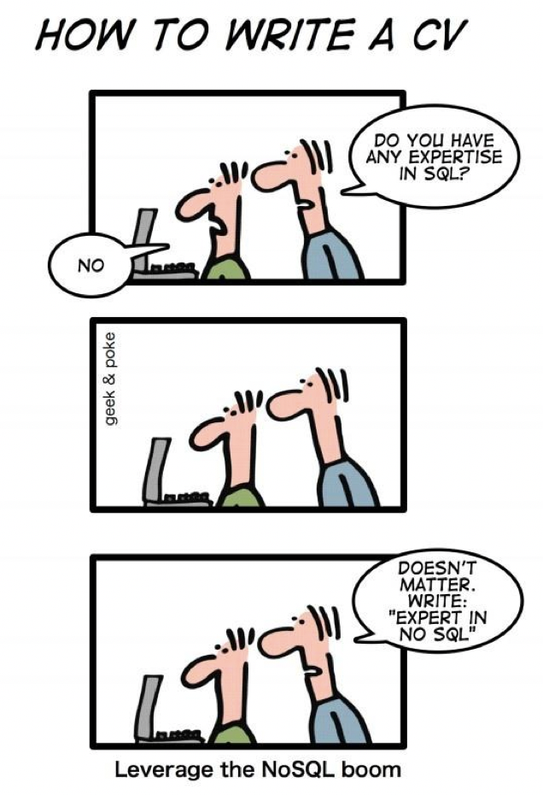
Today’s Plan
What is NoSQL?
Major types of NoSQL systems
Key concepts
Eventual Consistency
Duplication
Source: Cattell (2010). Scalable SQL and NoSQL Data Stores. SIGMOD Record.

Slide 43
Recall: Joins in RDBMS
Posts
Users
user_id | name
100 | Alice
101 | Bob
post_id | post | user_id
1 | Hello world | 100
2 | Bye world | 101
post_id | post | user_id | name
1 | Hello world | 100 | Alice
2 | Bye world | 101 | Bob

Slide 44
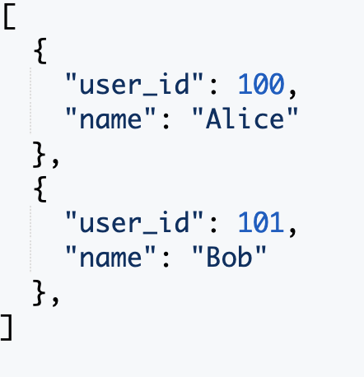
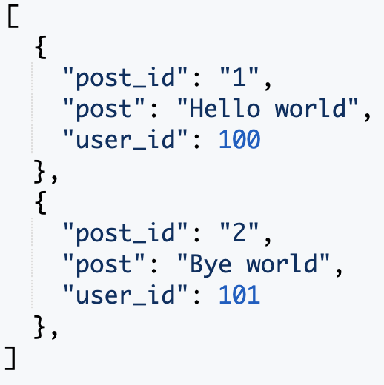
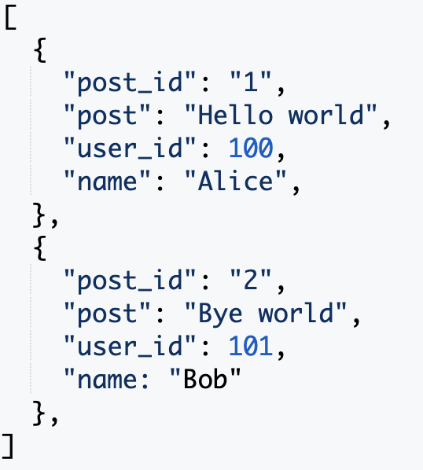
What if we want to display posts with usernames?
Users
Posts
Posts ( + username)
Answer 1: some NoSQL databases do support joins (e.g. later versions of MongoDB)
Answer 2: Duplication (i.e. ‘denormalization’)
‘Storage is cheap: why not just duplicate data to improve efficiency?’
Tables are designed around the queries we expect to receive. This is beneficial especially when we mostly need to process a fixed type of queries
Leads to a new problem: what if user changes their name? (this needs to be propagated to multiple tables)
Notes:
Duplication means that when updating the table, there is additional costs involved in keeping the tables in sync. So this is a tradeoff between fast reads and writes but additional update costs in NoSQL. In some cases updates may be rare, or even can be ignored, i.e. we allow the tables to go out of sync, which may be fine for some applications (e.g. it may be fine to display a post with the user name “at time of posting”). So in the end it is a tradeoff that has to be carefully made based on profiling, application / business needs etc.

Slide 45


Conclusion: Pros & Cons of NoSQL Systems
Pros
Cons
+ Flexible / dynamic schema: suitable for less well-structured data
+ Horizontal scalability: we will discuss this more next week
+ High performance and availability: due to their relaxed consistency model and fast reads / writes
- No declarative query language: query logic (e.g. joins) may have to be handled on the application side, which can add additional programming
- Weaker consistency guarantees: application may receive stale data that may need to be handled on the application side
Conclusion: no one size fits all. Depends on needs of application: whether denormalization is suitable; complexity of queries (joins vs simple read/writes); importance of consistency (e.g. financial transactions vs tweets); data volume / need for availability.
Binary view is oversimplified: NoSQL databases often still have SQL-like query languages (e.g. Cassandra) and tunable consistency levels.
Other alternative solutions: “NewSQL”, distributed SQL (e.g. Presto), PostgreSQL JSON, …
Need to understand tradeoffs to make an informed decision!
Source: Cattell (2010). Scalable SQL and NoSQL Data Stores. SIGMOD Record.

Slide 46
Acknowledgements
CS4225 slides by He Bingsheng
Penn State CMPSC 431W Database Management Systems (Fall 2015) – McGrawHill, Wang-Chien Lee, Yu-San Lin
mongodb.com, redis.com, openai.com, pinecone.io
Otter video from https://www.reddit.com/r/singapore/comments/mezgg3/otters_on_the_grass_at_botanic_gardens_today/

